Slide 1

Insurance Analysis

Slide 2

Project members:
Pankaj Singh
Vanga Bhargavi
Swapnil Dalimbe
Sweta
Lissa Dmonte
Shrishail Patil
Presented By Group 6

Slide 3



Introduction
Our project provides a detailed view of our insurance business performance, focusing on brokerage earnings, invoiced amounts, and target completion.
It enables us to track how well the branch and its account executives are performing in these key areas
Analysis
Focus
Evaluation
Analyzing key performance metrics for [Ahmedabad Branch ]
Focus on new products, cross-sell opportunities, and renewals
Evaluating account executives on meetings and open opportunities

Slide 4

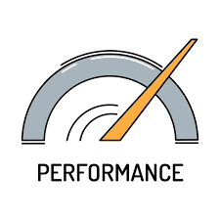



Focus Areas
Branch Performance
Client Meetings
Strategic Growth
Opportunities
Analyze key areas like new business, cross-sell opportunities, and renewals.
Monitor account executives' client meetings, as these lead to new opportunities and closed deals.
Includes data on account executives client meetings and the number of open opportunities, offering insights into current activities and future business potential.
Assess the branch's performance against its goals to identify strengths and areas for improvement.
By analyzing all the above parameters, we can refine our strategies to enhance overall performance.

Slide 5

Data Overview:
Six Excel sheets used: Brokerage, Fees, Invoice, Target Budget, Meeting, and Opportunities.
Linked tables via common columns like Employee or Account Executive names.
Combined fees and brokerage data to track achievement.
Target budget used to compare achievement and invoices against targets.
Monitored meetings and opportunities for business insights.

Slide 6

Objectives
Access branch performance
Compare the performance with the target
Identify the growth areas
Track client engagement
Improve strategic decision making
Performance bench Marking

Slide 7




Key Performing Indicators (KPI’s)
Number of Invoices by Account Executive
Yearly Meeting Count
This project focuses on the following KPIs:
Cross Sell--Target, Achievement, New
New-Target, Achievement, New
Renewal-Target, Achievement, New
Stage Funnel by Revenue

Slide 8


Key Performing Indicators (KPI’s)
Number of Meetings by Account Executive
Top Open Opportunity

Slide 9
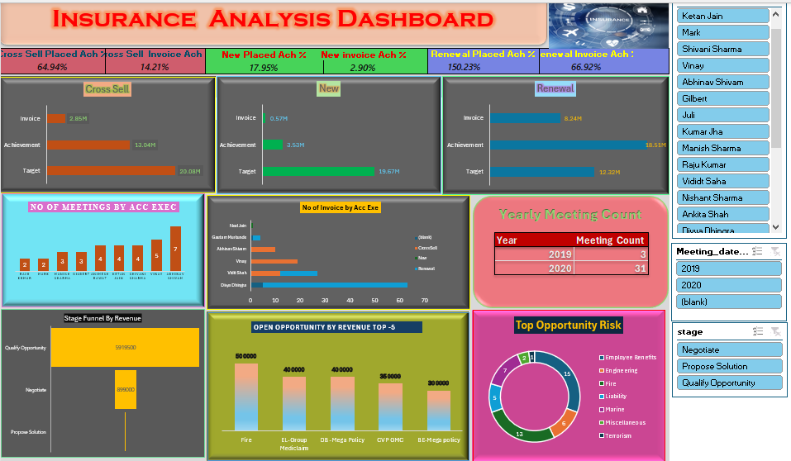
Excel Dashboard

Slide 10
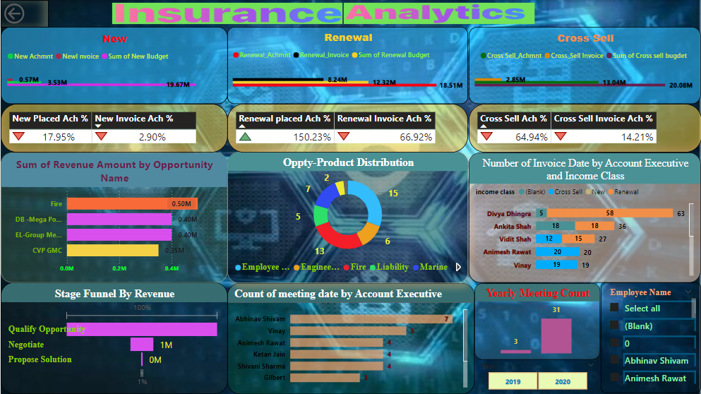
Power Bi Dashboard

Slide 11
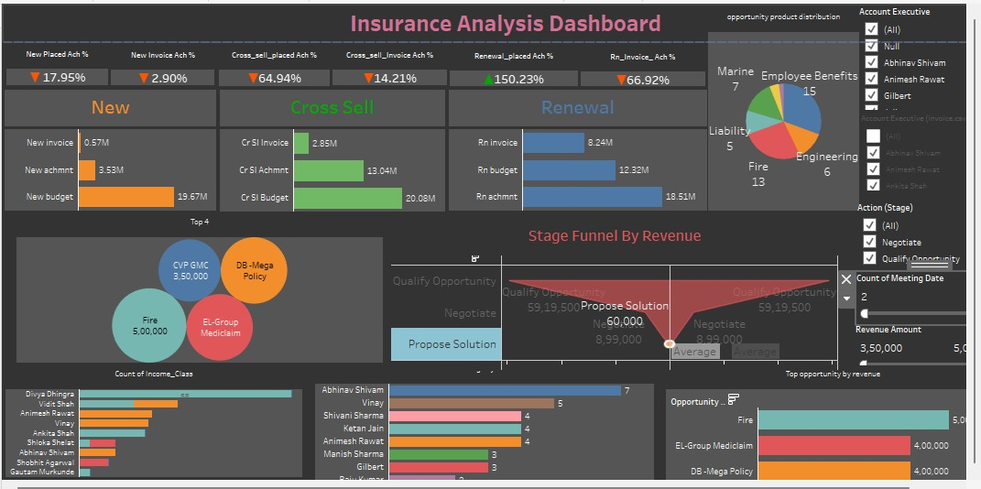
Tableau - SQL Dashboard

Slide 12

Analysis
Renewal is performing well, while new sales and cross-selling are lagging.
Frequent client meetings lead to more opportunities.
Some team members need support to improve client engagement.
Training can help boost interaction skills.
Sharing successful strategies could enhance team performance.

Slide 13
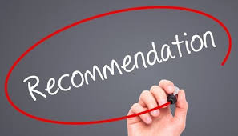
Recommendations:
1. Improve new sales and cross-selling efforts
2. Increase client meetings to boost opportunities.
3. Provide targeted training for better engagement.
4. Share successful strategies within the team.

Slide 14
Conclusion :
Strong retention provides a solid foundation, but focusing on new sales and cross-selling is key to driving growth.
Converting open opportunities into closed deals, along with improved client engagement, will enhance overall performance.
Branch is providing good customer service that helps in customer retention

Slide 15


Mentor : Akshay Kumbhar
Co-Mentor : Vitthal

